Slide 1
Module 3 : Data Encoding

Slide 2
Categorical Data Encoding Techniques
Data Encoding is an important pre-processing step in Machine Learning.
It refers to the process of converting categorical or textual data into numerical format, so that it can be used as input for algorithms to process.
The reason for encoding is that most machine learning algorithms work with numbers and not with text or categorical variables.

Slide 3
What is Categorical Data?
When we collect data, we often encounter different types of variables.
One such type is categorical variables.
Categorical variables are usually represented as ‘strings’ or ‘categories’ and are finite in number.
Here are a few examples of categorical variables:
Places: Delhi, Mumbai, Ahmedabad, Bangalore, etc.
Departments: Finance, Human resources, IT, Production.
Grades: A, A-, B+, B, B- etc.

Slide 4
Types of Categorical Data
There are two types of categorical data -
Ordinal Data
Nominal Data

Slide 5
Ordinal Categorical Data
The categories of ordinal data have an Inherent Order.
This means that the categories can be Ranked or ordered from highest to lowest or vice versa.
For example, the variable “highest degree a person has” is an ordinal variable.
The categories (High school, Diploma, Bachelors, Masters, PhD) can be ranked in order of the level of education attained.

Slide 6
Nominal Categorical Data
The categories of nominal data do not have an Inherent Order.
This means that the categories cannot be ranked or ordered.
For example, the variable “city where a person lives” is a nominal variable.
The categories (Delhi, Mumbai, Ahmedabad, Bangalore, etc.) cannot be inherently ranked or ordered.

Slide 7
What is Data Encoding?
Data Encoding is an important pre-processing step in Machine Learning.
It refers to the process of converting categorical or textual data into numerical format, so that it can be used as input for algorithms to process.
The reason for encoding is that most machine learning algorithms work with numbers and not with text or categorical variables.

Slide 8
Why Data Encoding is important?
Most machine learning algorithms work only with numerical data, so categorical variables (such as text labels) must be transformed into numerical values.
This allows the model to identify patterns in the data and make predictions based on those patterns.
Encoding also helps to prevent bias in the model by ensuring that all features are equally weighted.
The choice of encoding method can have a significant impact on model performance, so it is important to choose an appropriate encoding technique based on the nature of the data and the specific requirements of the model

Slide 9
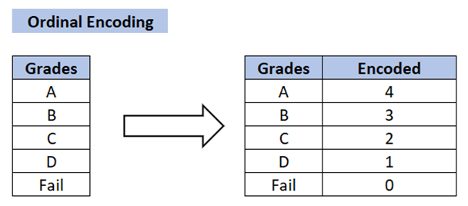
Ordinal Encoding
Ordinal Encoding is used when the categories in a variable have a Natural Ordering.
In this method, the categories are assigned a numerical value based on their order, such as 1, 2, 3, etc.
For example, if a variable has categories ‘Low’, ‘Medium’ and ‘High’, they can be assigned the values 1, 2, and 3, respectively.

Slide 10
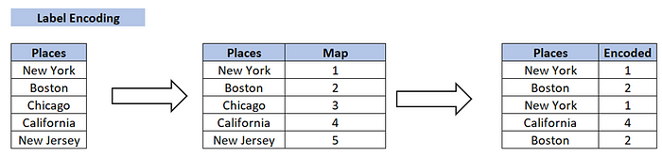
Label Encoding
Each unique category is assigned a Unique Integer value.
This is a simpler encoding method, but it has a Drawback in that the assigned integers may be misinterpreted by the machine learning algorithm as having an Ordered Relationship when in fact they do not.

Slide 11
One Hot Encoding
One-Hot Encoding is the most common method for encoding categorical variables.
A Binary Column is created for each Unique Category in the variable.
If a category is present in a sample, the corresponding column is set to 1, and all other columns are set to 0.
For example, if a variable has three categories ‘A’, ‘B’ and ‘C’, three columns will be created and a sample with category ‘B’ will have the value [0,1,0].

Slide 12
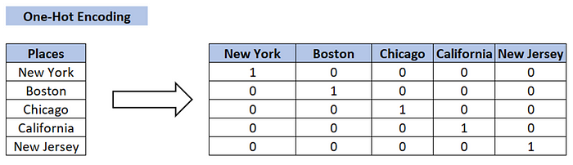

Slide 13
Dummy Encoding
Dummy coding scheme is similar to one-hot encoding.
This categorical data encoding method transforms the categorical variable into a set of binary variables [0/1].
In the case of one-hot encoding, for N categories in a variable, it uses N binary variables.
The dummy encoding is a small improvement over one-hot-encoding.
Dummy encoding uses N-1 features (binary variable) to represent N labels/categories.

Slide 14
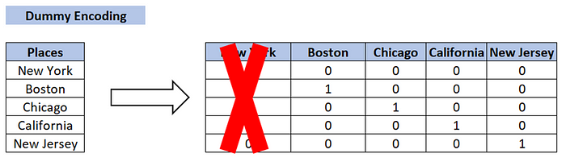

Slide 15
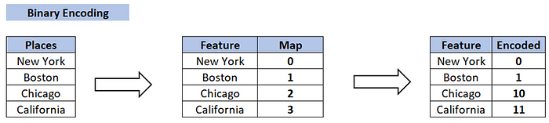
Binary Encoding:
Binary Encoding is similar to One-Hot Encoding, but instead of creating a separate column for each category, the categories are represented as binary digits.
For example, if a variable has four categories ‘A’, ‘B’, ‘C’ and ‘D’, they can be represented as 0001, 0010, 0100 and 1000, respectively.

Slide 16
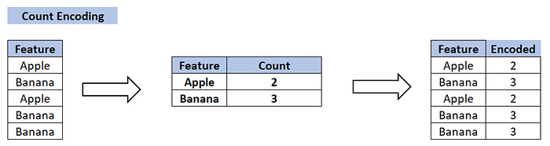
Count Encoding:
• Count Encoding is a method for encoding categorical variables by counting the number of times a category appears in the dataset.
For example, if a variable has categories ‘A’, ‘B’ and ‘C’ and category ‘A’ appears 10 times in the dataset, it will be assigned a value of 10.

Slide 17
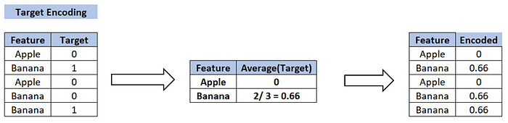
Target Encoding
This is a more advanced encoding technique used for dealing with high cardinality categorical features, i.e., features with many unique categories.
The average target value for each category is calculated and this average value is used to replace the categorical feature.
This has the advantage of considering the relationship between the target and the categorical feature, but it can also lead to overfitting if not used with caution.

